Slide 1
Good practices when working with autistic children in an inclusive environment
Based on experience of Mrs. Stefanova
Special education teacher

Slide 2
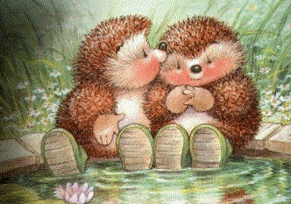
The Fable about the Hedgehogs
Conclusion: The best relationship is not the one between ideal people, but the one in which everyone learns to live with the defects of others and recognize their qualities.

Slide 3
The Beginning…
non-communicating, speaking inaccurately and mispronouncing words
Moving chaotically in an erratic manner
Unacceptable social behaviour
Socially isolated
not participating in group activities, celebrations and other appearances of the group

Slide 4
Step One…
The most important thing for the team was to create an environment that’s supportive and tailored to the individual needs of the child to ensure inclusion in the group.
As for his adaptation in the “Daga(Rainbow)" KG - Debelt, it was crucial to build trust and cooperation between the family, the specialists and the teachers in the kindergarten.
Practice has shown that when parents and teachers from the group are actively involved in the process of coordination and harmony between all sides, significant progress can be made in terms of the child’s progress.

Slide 5
Highlights
The child was assisted during group work to facilitate its inclusion in gaming, training and daily activities and aid the correction of unacceptable behavior, the development of new adaptive models, and the ease of communication.
Depending on the needs of the child, the resource teacher judged how to work individually with the child.

Slide 6
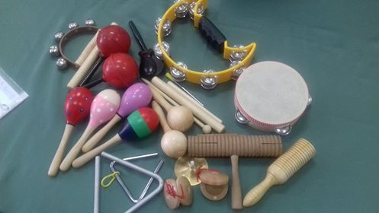
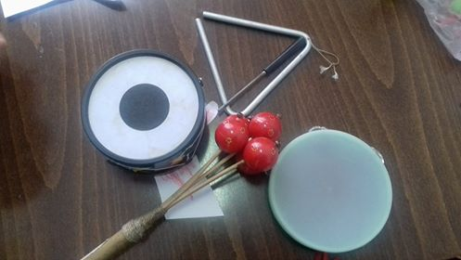
Musical activities
The main method we used to work with Alex for his inclusion and growth is so called “Shulverk system” - a "philosophy" of music education.
This is an active form of work with musical instruments. The child responds to rhythm, movement, and music, which improves communication skills.

Slide 7
Music Therapy
Music therapy is entertaining and combats stress, creates a sense of belonging to the group, facilitates rapid rapprochement and confidence building.
It gave to Alex the opportunity to use different ways of communication - through gestures, mimics, and musical instruments.
Music gave the child emotional freedom and the opportunity for self-expression.

Slide 8
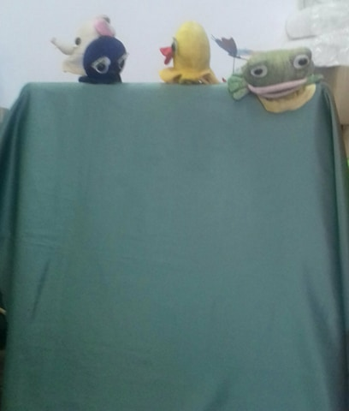
Doll Theraphy
The use of fairy tales and recreating engaging stories created an environment in which the child passes its feelings to the doll, forgetting about its problems and fears.
In working with the child, emphasis was placed on its abilities and potential, not on its deficits.

Slide 9
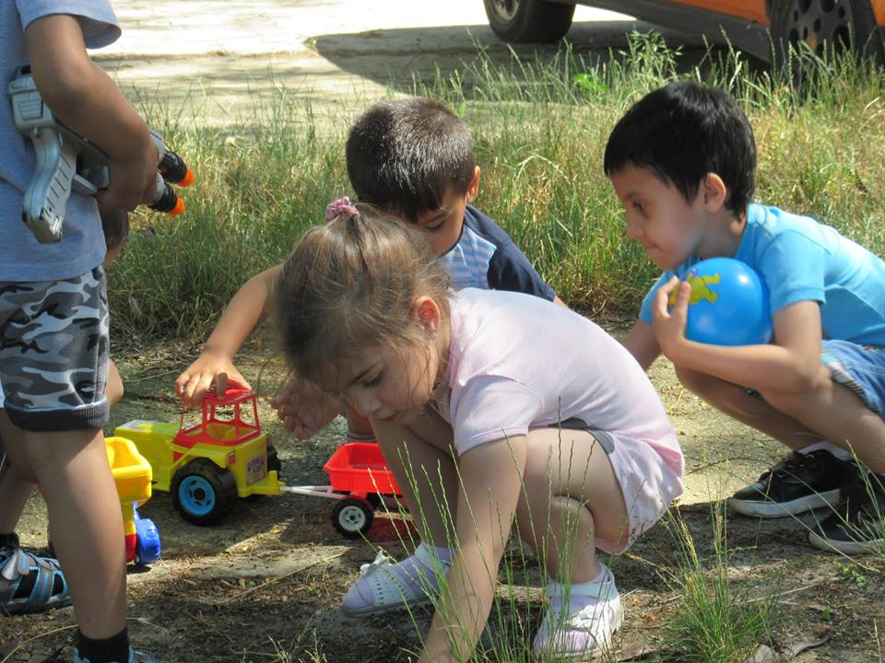
Group Work
Role plays and teamwork with other children helped Alex to learn while having fun and made him feel comfortable among his peers, while they learned to accept his differences.

Slide 10
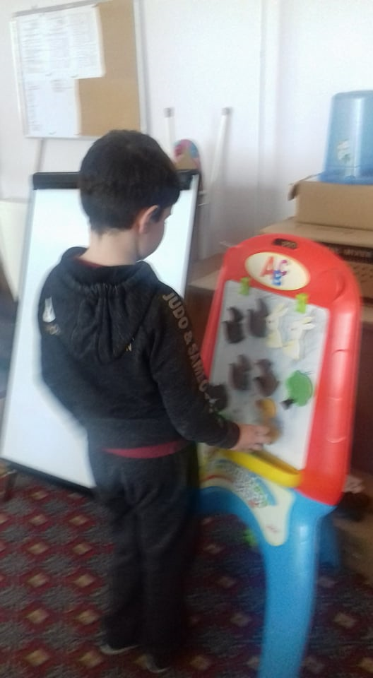
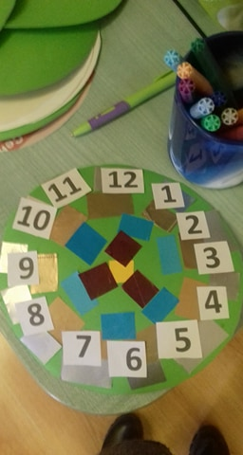
Preparing for School
In the individual activities with the child we learn new concepts, recognizing animals, plants and objects.
We learn letters, figures, short sentences and poems.

Slide 11
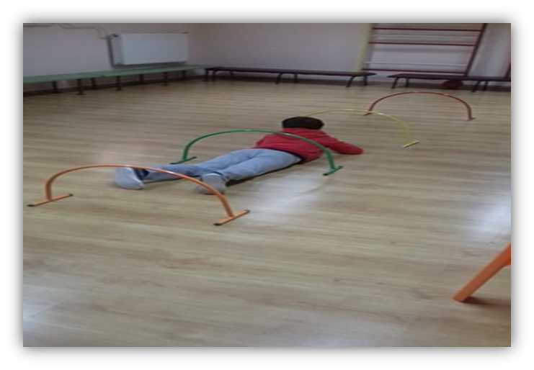
Exercise
Anxiety is characteristic for children with autism.
Therefore, we focused on the physical development of the child.
Physical exercise leads to physical strengthening, increased endurance, and reduces stress.
Exercise also develops concentration and patience.

Slide 12
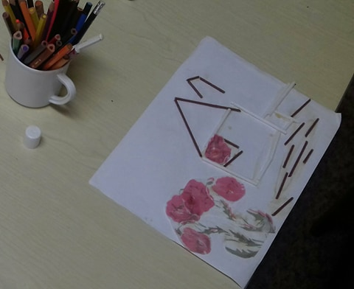
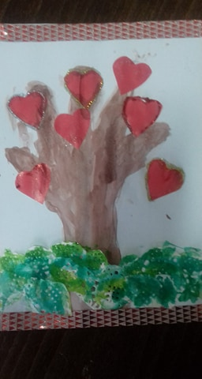
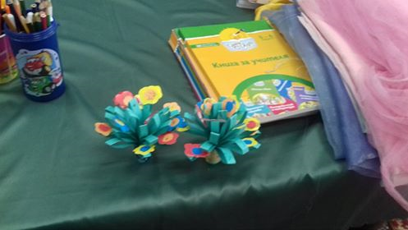
Applied Art

Slide 13
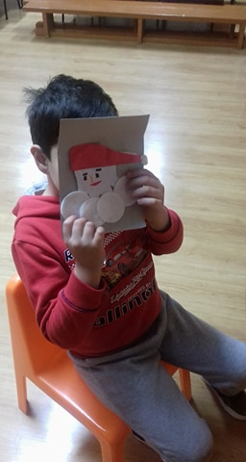
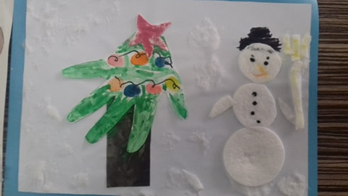
Working with papier
Drawing and Contouring

Slide 14
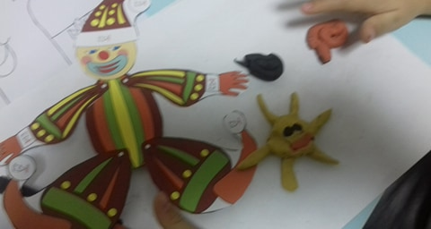
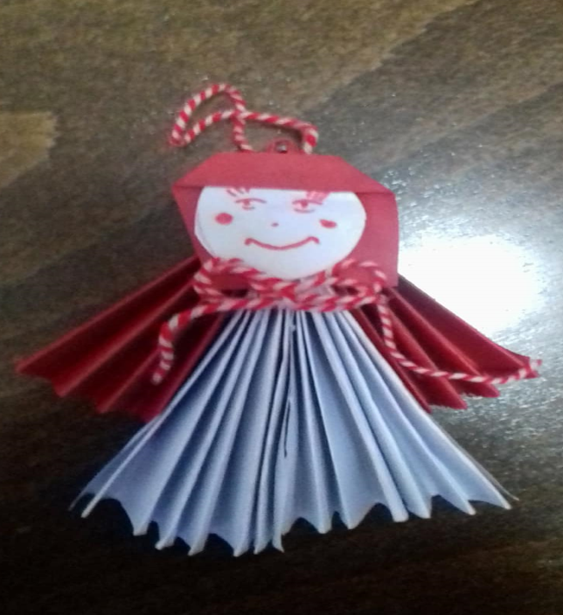

Slide 15
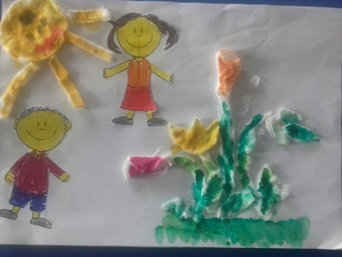
What we’ve learned

Slide 16
Socializing
The socialization of Autistic children is a challenging, lengthy and unequal process in which teachers and parents build together their common work ethic and relationships.
The main focus of the team's work was to build an educational environment that made it possible to adapt the child while also aiding the teachers in unveiling the child’s abilities.
Considering Alex's individual abilities and the support plan, we helped the child fully participate in the educational process and social life of the kindergarten.

Slide 17
Road to Success
When working with a child, the expectations of it should not be too high and cause anxiety, neither should they be too low, causing despair. A good learning pace will encourage the child and increases his / her self-esteem. In this case, we apply empathy as a method.
We use encouragement and good attitude.
A steady pace has helped the child master skills and become confident in their own capabilities and autonomy.

Slide 18
Alex’s Achievements
He’s adapted to the conditions of the kindergarten.
Socially unacceptable behavior is increasingly rare.
He smiles more and is more confident in his options.
He’s more communicative.
He knows some letters and words.
He uses simple sentences and memorizes poems.
Self-service skills.
Improved coordination, concentration and attention.

Slide 19
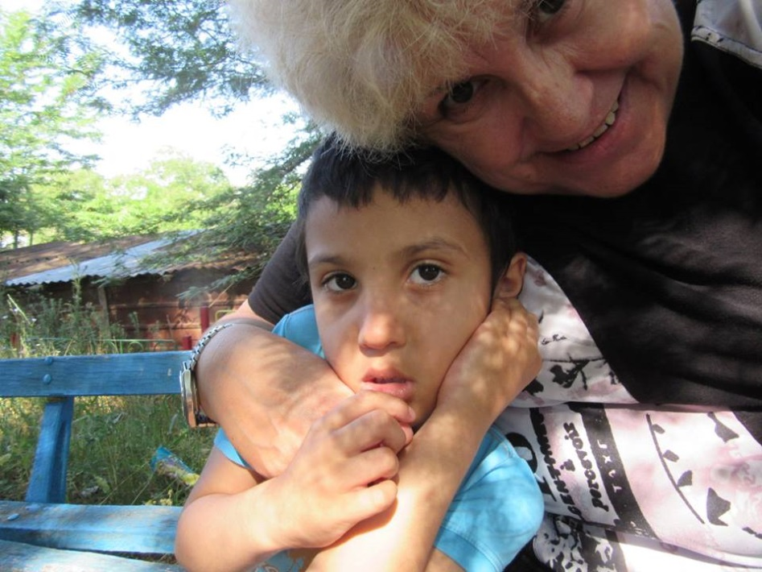
The biggest awards for the teachers and his family:
trust
Alex’s happiness

