Slide 1
AMUSE PROJECT GOOD PRACTICE FORM
Name of the Good Practice: The Challenges of Working with Asperger Syndrome
Tags: Student Аsperger syndrome literary skills communication problems success challenge

Slide 2
Description of the good practice:
Student with Asperger Syndrome, who has communication problems, aggressive acts and conflict with some teachers, but manages to turn literature from a favourite hobby into a successful learning subject.

Slide 3
Extended Information
Goal: (you can choose more than one)
a) included in school/society
b) Pupil well-being
c) Cognitive accessibility
d) Independent / life skills
e) Academic skills
f) Social communication

Slide 4
Students age range: (Write the ages of the students eg.10-15 )
15 years old boy.
Curriculum area: (Choose one of them)
a) Not related
b) Maths
c) Literacy
d) Foreign Language
e) Science
f) Arts
g) Physical Education
h) Technology
i) Humanity

Slide 5
Year Period: (when can this practice be used - choose one of them)
a) Any moment
b) Course start and preparation
c) All year long
d) Course end

Slide 6
Step by step description, including actions to be developed for preparation and implementation
1. Introduction with the student’s character and building trust- about 2-3 months.
2. Acquaintance with the strong and weak sides of the social, communication, life and literary skills.
3. Individual psychological therapy- the purpose is increasing self- esteem, reducing aggressive behaviour, achieving socially acceptable behaviour.
4. Establishing an unusually high interest in literature.
5. Clarify the reasons for the poor ratings on literature at school- it`s difficult to communicate with persons, who doesn`t like (especially teachers).
6. Working for developing skills for tolerance- group therapy with the most unpleasant to him classmates.
7. Meetings and friendly conversations with psychologist and literature teacher.
8. Conversations with psychologist about favourite literary works- discussion of the literary images and characters.
9. Use of interest in literature to increase motivation for high scores.
10. Improving communication and life skills and suppression of aggressive acts.

Slide 7
Resources to be used, including human resources, materials and spaces:
Appropriate material base, individual consultations, daily therapy with a psychologist, organizing group therapy specially for the student, literary works other than the curriculum.

Slide 8
Difficulties found while implementing it and suggestion:
The main difficulty was his total refuse to communicate with people, who doesn`t approve- especially literature teacher and most of classmates.
Lack of co-operation by a class supervisor and classmates.
Lack of co-operation by a parents, who was frustrated and irritated by his behaviour.
Overcoming aggression.
Motivation for good assessment of the subject.

Slide 9
Building rules for right and wrong behaviour.
Building skills for respect for authority.
The official webpage for the good practice:
https://drive.google.com/drive/my-drive

Slide 10
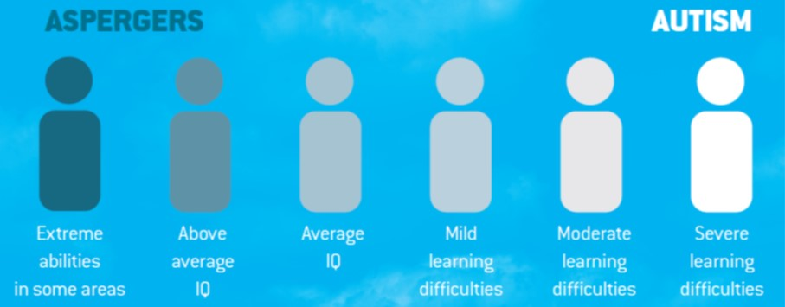
Image related with this practice:

Slide 11
Downloadable Materials
If you have some downloadable materials for that good practice please upload them on your Google drive and provide a link for them so that other teachers can download and use them in their classrooms

